Slide 1

Globox Project
Food and Drinks Product Category

Slide 2
Agenda slide
Introduction to the A/B test and GloBox
Methodology and experimental setup
Results and key findings
Recommendation
Conclusion

Slide 3
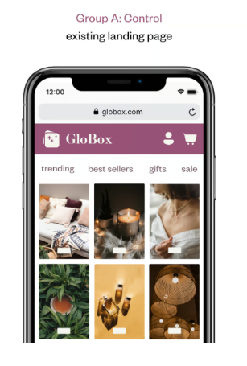
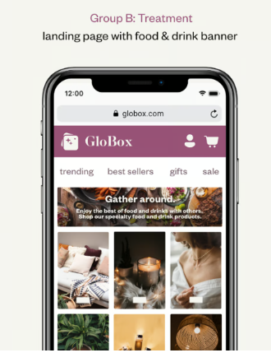
A/B test setup
Experiment platform
Group A: Control; Group B:Treatment
Banner for food and drink category created
Group A does not see the Banner while Group B does
Random sampling
3

Slide 4

Introduction
Glo Box is a mobile e-commerce platform that specializes in sourcing unique and high-quality products from around the globe.
The firm is determined to raise awareness about the food and drink product category by enhancing the mobile webpage of the company to boosting revenue.
A/B testing analysis was used for the experiment.

Slide 5
Results finding
The conversion rate in Group A has a total of 3.92% with 955 users, while Group B has a total of 4.63% with 1139 users.
The average amount spent in Group A is $3.37, whereas the average amount spent in Group B is $3.39.

Slide 6
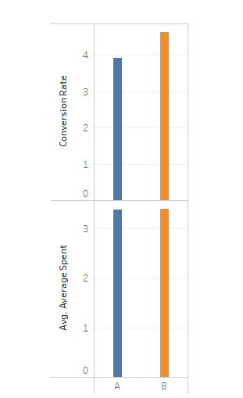
Conversion rate and average amount spent
Conversion rate in Group A is 3.92%; Group B is 4.63%; difference of 0.71%
Average amount spent in Group A is $3.37; Group B is $3.39; difference of $0.01
6

Slide 7
Distribution of the amount spent for each group
The Boxplots below shows that the distribution of the amount has similar median spending of $64 for Group A and $52 for Group B
Group A has a wider interquartile range compared to Group B. This suggests greater variability in the data points within Group A

Slide 8
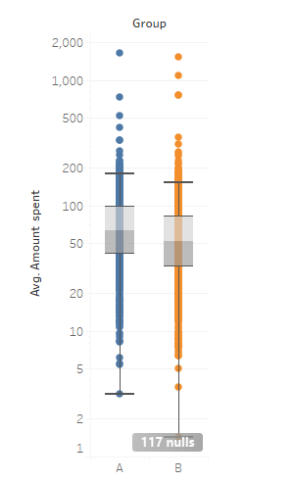
Distribution of amount spent
There is similar median spending of $64 for Group A and $52 for Group B
Greater variability in the data points exist within Group A

Slide 9
Relationship between the test metrics and the user’s device
Use
Use of iphone had average total spending of $75.71 in Group A.
Use
Use
Use of iphone had average total spending of $68.22 in Group B.
Use
The use of Android phone had average total spending of $62.47 in Group B.
The use of Android phone had average total spending of $74.48 in Group A.

Slide 10
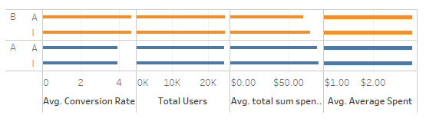
The analysis indicate that the use of iphone had the highest average total spending of $75.71 in Group A
User’s device
.

Slide 11

Relationship between the test metrics and the user’s gender
Females in Group A had an average total spending of $76.75
Females in Group B had an average total spending of $63.16
Males in Group A had an average total spending of $72.84
Males in Group B had an average total spending of $65.47

Slide 12
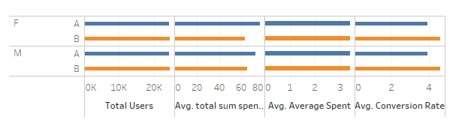
The analysis shows that Females in Group A, had the highest average total spending of $76.75 more than their Male counterpart.
User’s gender

Slide 13
Relationship between the test metrics and the user’s country
 | AUS | BRA | CAN | DEU | ESP | FRA | GBR | MEX | TUR | USA
Group A | $78.34 | $72.65 | $68.76 | $95.32 | $68.31 | $82.24 | $64.52 | $87.03 | $79.24 | $73.06
Group B | $68.54 | $64.17 | $62.64 | $56.49 | $84.96 | $53.79 | $95.27 | $66.65 | $59.96 | $63.69

Slide 14
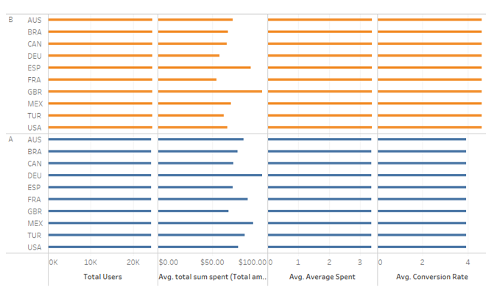
Germany has the highest average spending with $95.32 in Group A
User’s country

Slide 15
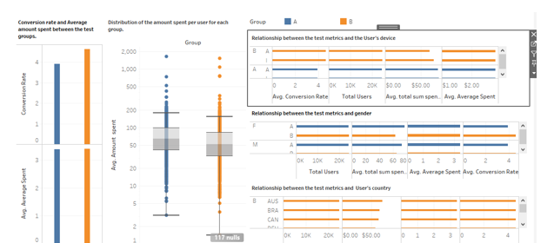
Globox dashboard system

Slide 16

Recommendations
Based on the findings, we recommend against the launch of the new banner feature. Our analysis did not demonstrate a substantial improvement in our key success metrics. Therefore, it does not appear justified to release the feature to all users.
The cost-benefit analysis indicates that the perceived cost of launching the feature outweighs the potential benefits, especially considering the lack of significant improvements in conversion rates and average spending.
We believe that further refinement or reconsideration of the feature may be necessary before proceeding with a full-scale launch.

Slide 17

Limitations in the A/B test of the project
The outliers in Group A and B pose a risk of distorting results in the experiment especially in the distribution metrics
Filtering out nulls in the datasets could impact our analysis negatively and raising concerns about data loss and potential bias.
Acknowledging and addressing these limitations is crucial for a comprehensive understanding of the experiment results.

Slide 18
Conclusion
The experiment provided valuable insights however, the data did not support the implementation of the new banner feature at this time
We suggest revisiting the feature design and conducting additional tests to explore alternative strategies for achieving our desired outcomes

Slide 19
Thank you for Listening
Ejikeme Justine Ekwem
Master school

